Slide 1
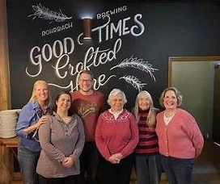
During the past year, here are some of the new things we tried …
Events
Lunch Bunch
“Happy” Hour(s)
Wizard of Oz
Notes:
In 2021, Long Range Planning embarked on a mission to map out a 5-year plan and an initial strategic plan was developed. During the past year, here are some of the new things we tried….
We had a few social events like The Wizard of Oz and Song Hill Winery. A sub-group, called the Lunch Bunch met several times, and a few happy hour and dinner events were planned; including ice cream at Pittsford Dairy, Rorhbach’s, Trata and the Old Farm Cafe

Slide 2
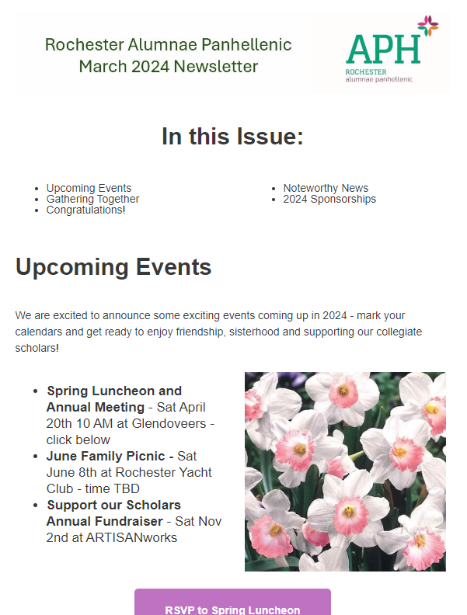
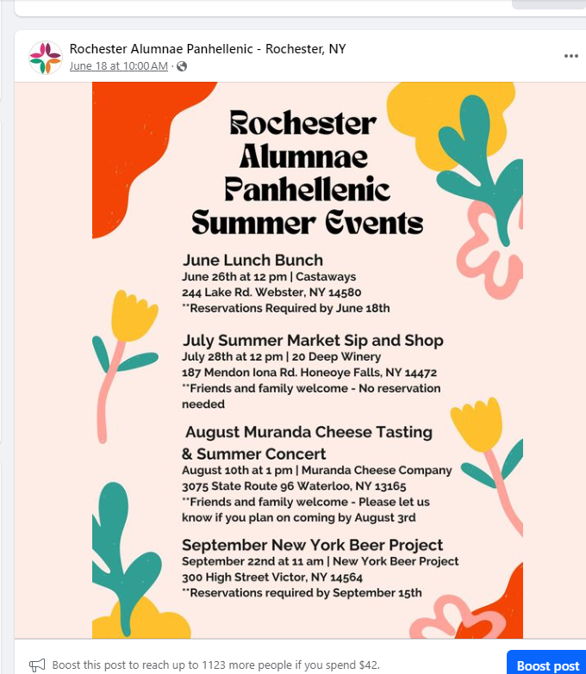
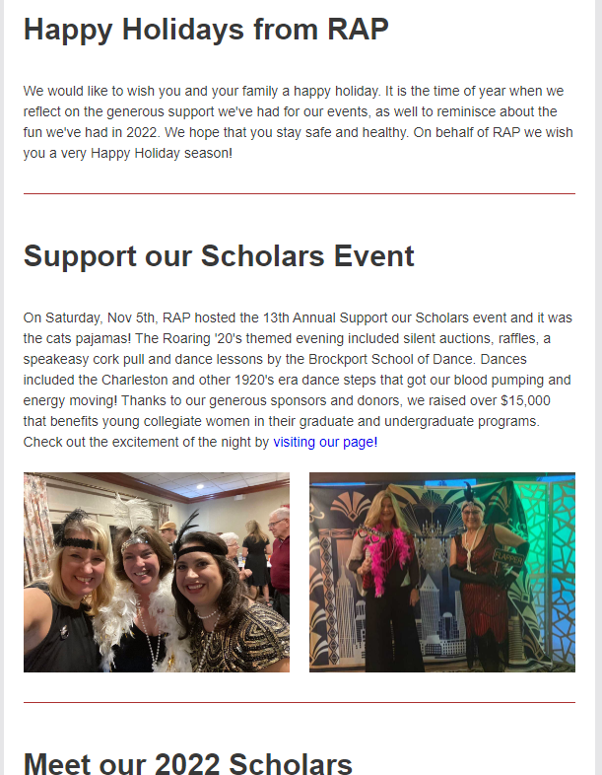
The idea behind the new things was to strengthen RAP (and have some fun)
Multiple email communications, and multiple posts (not including SOS) to keep members, sponsors and ‘friends’ updated
Published 3 Quarterly RAP E-Newsletters
VP’s connected with new incoming delegates
VP's reached out to dormant alumnae sorority groups
Scholarship committee had presentations with all local campuses about scholarship awards
Notes:
Three other initiatives were to A) communicate more with our members, sponsors and “friends of SOS”, B) have the Vice President do more outreach to new delegates and missing groups, and C) having the Scholarship committee proactively visit the collegiate campuses.

Slide 3
RAP 2030
The Rochester Alumnae Panhellenic
Strategic Plan
Notes:
The Long Range Planning committee built on those blocks by evaluating the events and ideas that have been working and fine-tune the 5-year plan. Thus.. The RAP 2030 strategic plan was born!

Slide 4
Introducing… RAP 2030
RAP 2030 Goal
Continue to strengthen the Rochester Alumnae Panhellenic into a thriving, inclusive and vibrant organization preparing for the future of Greek life
Our strategic plan to move the organization forward
Notes:
Our Goal is to continue to strengthen the Rochester Alumnae Panhellenic into a thriving, inclusive and vibrant organization preparing for the future of Greek life.

Slide 5
RAP 2030 Target Areas
The Long Range Planning Committee identified four Target Areas:
Membership, Recruitment & Retention
Communications and PR
1
2
Social Activities
Community Engagement & Philanthropy
3
4
Notes:
Here are the 4 areas of focus for the 2030 Plan –
1 – Membership, Recruitment and Retention
2- Communications and Public Relations
3 – Social Activities
4 – Community engagement and philanthropy

Slide 6
Membership, Recruitment & Retention
1
Create a welcoming environment for all members with a special emphasis on new members
Provide an annual yearbook with member and organization info
Develop a mentor program to support new members, to provide a solid introduction to RAP, and to follow up throughout the year
Implement positive ways to let all members know that they are appreciated and valued
Develop a “dormant chapter” outreach plan
Engage with local collegiate groups
Reach out to past scholarship winners
Notes:
These are the initial ideas from LRP, it is not necessarily a list of “to-do” – those on those committees will have the flexibility to take ownership of each target area. These are simply thought-starters.

Slide 7
Communications and PR
2
Develop, implement and annually revise an engaging communications plan for the organization
Generate a regular newsletter sent out to all members and supporters of RAP
Actively collect and solicit photos of RAP events, events of our member groups, and our Collegiate Panhellenic Councils to share
Enhance our social media presence by regularly and actively posting on our Facebook page, website and Instagram accounts
Encourage members to actively participate in sharing social media posts and our newsletters
Highlight the impact and success stories of the organization including our scholarship winners through local media outlets

Slide 8
Social Activities
3
Develop a wide range of social activities that will target different populations of our members
Consider all demographics: Include collegian-alumnae groups, retirees, young parents, families, and others
Consider a variety of formats: in person and on-line events
Ensure that events are cost effective and open to everyone

Slide 9
Community Engagement & Philanthropy
4
Identify ways to engage and support member philanthropies
Collect information on each sorority’s National/Local philanthropy
Determine if member groups want to have their philanthropy’s fundraisers communicated broadly
Consider ways to identify RAP (perhaps a RAP sweatshirt or t-shirt) to wear when supporting local philanthropies
Evaluate philanthropic activities to do with collegians; engage/support collegians’ philanthropy efforts, revisit the idea of the “winter event”

Slide 10
RAP 2030 Timeline
Year 1 (2024-2025) Finalize the 2030 plan and goals, develop action items for each target area
Year 2 (2025-2026) Continue to develop and refine the action items and goals, testing areas for success in each target area
Year 3 (2026-2027) Implementation, assessment and adjustment
Year 4 (2027-2028) Implementation, assessment and adjustment, including new action items
Year 5 (2028-2029) Implementation, assessment and adjustment
Year 6 (2029-2030) Evaluation of goals, decision to continue on initial target areas or new areas of concern
Notes:
While LRP originally meant to embark on a 5-year plan, we realized that this plan is ever changing and we needed additional time to develop these ideas – plus 2030 is a nice round year! It is hard to believe that 2030 will be here before you know it.

Slide 11
So What Happens Next?
Each Target Area has a leader:
Membership, Recruitment and Retention – Jennifer DeVore
Communications and PR – Michele Gennarino
Social Activities – Marcia Miller
Community Engagement and Philanthropy – Renee Lanthier
Leaders use their committees and/or RAP members to:
Form a Planning Team: Assemble a diverse group from within the organization and members at large
Gather Input: Engage stakeholders through surveys, interviews, and focus groups to understand their perspectives, needs, and ideas
Implement actions to start making progress
Develop goals, measurements and actions
Provide a status report in January 2025 and annual report in June of each year
Notes:
I am sure you are each asking – so, what happens next?
Each target area has someone who has volunteered to lead each endeavor.
Each leader will either have a committee or a few members that will:
Form their Planning Team
Gather input from the membership and the community
Present the ideas and plans, implement those action items – measure & evaluate the progress of the idea/event and provide a status report in January and June.

Slide 12
How does everyone contribute?
Keep the four Target Areas in mind when working with your committee.
How can the plans of your committee help drive the Target Areas?
How can we communicate this to our members?
How can we publicize this to our constituents?
Support the leaders of the Target Areas.
Volunteer to help them with their plans.
Share your ideas.
Have a conversation with the leader(s).
Notes:
So how can you contribute if you are not on one of the committees or groups?
When working with / or serving on any committee, or out in the community… keep the four target areas in mind.
How can we communicate this to our members?
How can we communicate this to our donors, sponsors and friends of SOS?
Don’t be afraid to have a conversation with the leader of each target area.
Share this strategic plan with your own members.
Share your ideas with your own group and engage with your sisters… ask them if they want serve or participate on any committee!
Committee members do not need to be just our delegates and alternates – get everyone involved!

